Slide 1


CITS1003 Introduction to Cybersecurity [8] Incidents and Forensics
Dr David Glance

Slide 2
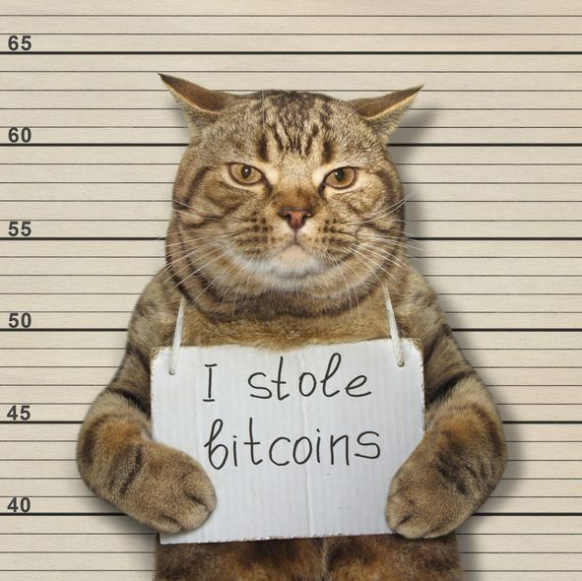
A unit about cats cybersecurity
https://depositphotos.com/portfolio-7863750.html

Slide 3
3 things
Understand what a cybersecurity incident is
1
Understand the process of incident response
2
Understand the role computer forensics plays in incident response
3

Slide 4
Definition of an Incident
Any event that has compromised confidentiality, integrity or availability of an organisation’s assets
From a VERIS perspective, an incident is the result of an Actor, taking some Action, on an Asset, resulting in the Attributes of an incident, i.e., how it was affected. In this case, the action exploits a vulnerability in the asset
An incident is when there is actual loss or imminent threat of loss. Otherwise, it is an Event
Standard for incident handling is NIST SP800-61 it defines an incident as:
“A computer security incident is a violation or imminent threat of violation of computer security policies, acceptable use policies, or standard security practices”

Slide 5
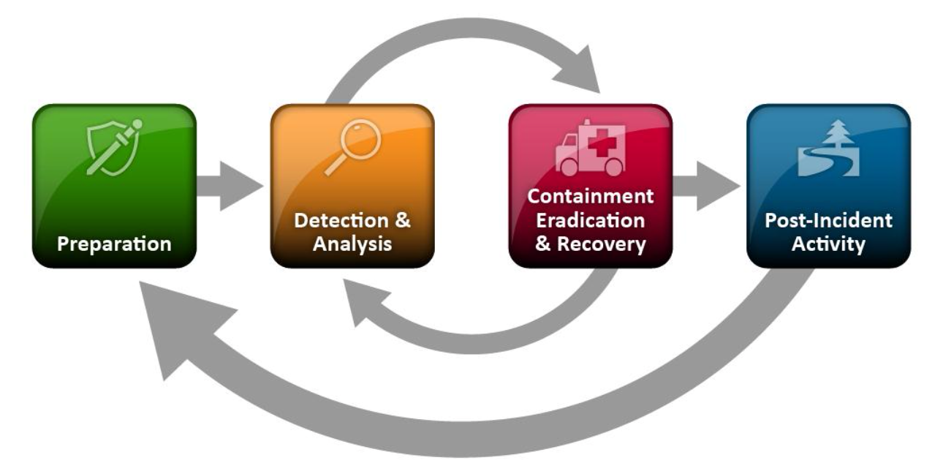
Handling an Incident

Slide 6
Note about “Hack back”
In the process of investigation and remediation, there may be the temptation to take direct action against hackers. This is known as “Hack back”.
Very few organisations or governments think this is a good idea (despite some enthusiasm from certain politicians in the US and UK)
There is no legal basis for it as hacking back may involve other countries, other infrastructure and innocent third parties
It is not the role of a business to engage in cyber actions and this should be left to legal authorities

Slide 7
Incidents: Incident Response Team
Not all organisations can afford a dedicated incident response team
A service offered by outside contractors as well as through cyberinsurance companies
Need to have a variety of skills:
Technical: cybersecurity, programming, IT, networks, forensic cybersecurity
Communications: liaising with senior staff in organisation and outside organisations
Stressful environment on 24x7 call
Can be involved in security awareness training and also information sharing with other companies and CIRTS/CSIRTS/ISACS
Have a Jump Bag with hardware and information needed for handling a response

Slide 8
Incidents: Detection
Incidents may come to light through alerts from
IDPS
Anti-malware software
Users noting irregular behaviours on their computers or accounts
Breached data surfacing on the Dark Web or other criminal sites
Dwell time: amount of time an attacker spent on a system before detection determined from:
Mean Time to Detect (MTTD) and Mean Time To Respond/Remediate (MTTR)

Slide 9
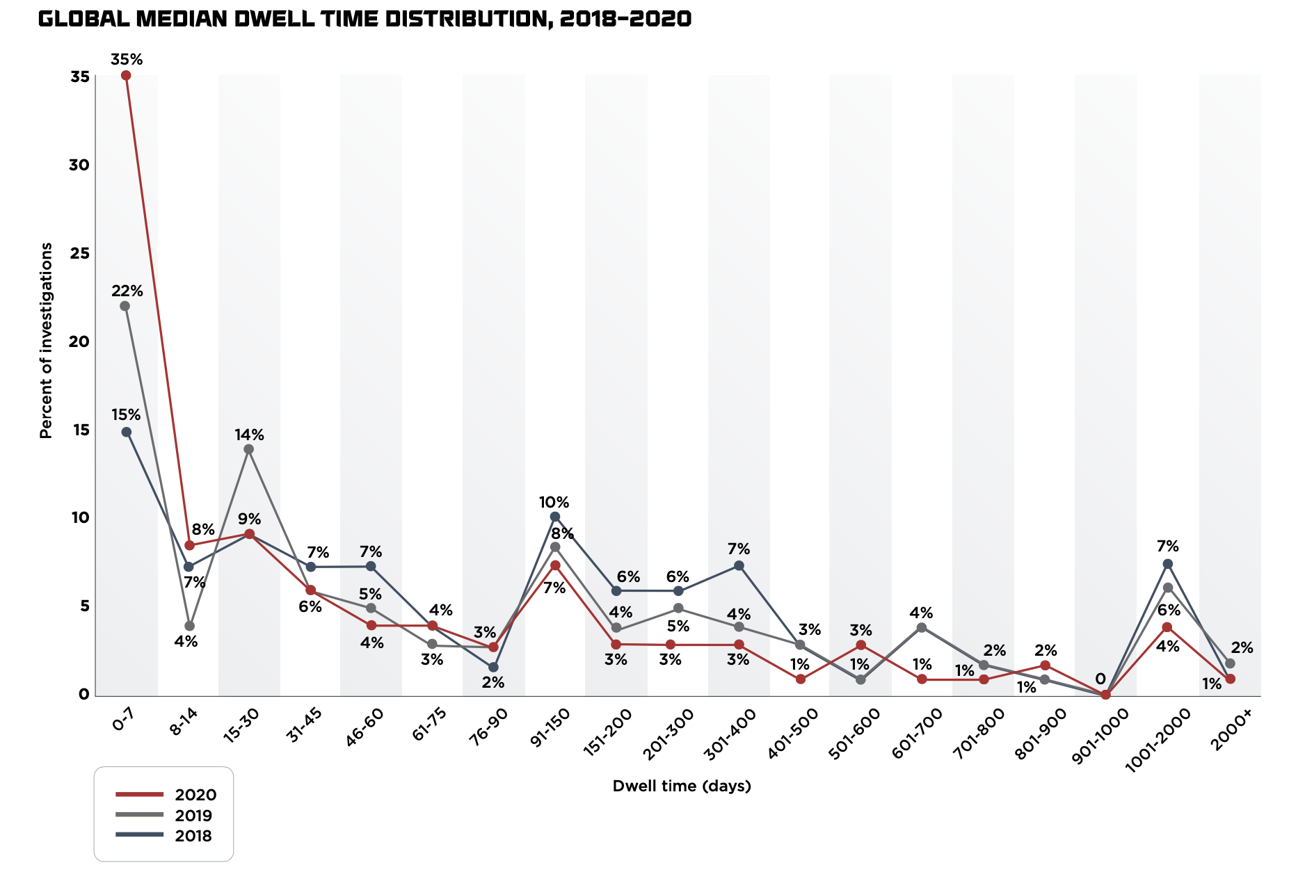
Dwell Time
Median dwell time
2011: 416 days
2020: 24 days
External detection: 73 days
Internal detection: 12 days
US 60% internal vs 40% external
Main reason for improvement is not sophistication but the increase incidence of ransomware!
From Mandiant FireEye M-Trends report https://content.fireeye.com/m-trends/rpt-m-trends-2021

Slide 10
Incidents: Detection and Analysis
During this phase, the team are trying to answer the question
Who?, What?, Where?, Why? and How?
Have to be careful since incidents may be the subject of criminal proceedings and so evidence needs to be collected to preserve chain-of-custody.
This requires special equipment that can be shown not to alter information, for example from a disk copy or during the examination of a computer

Slide 11
Incidents: Making detection and analysis easier
Detection is simpler if system and network operation procedures are set up in a way to facilitate this
Understand normal behaviours
Have a log retention policy
Perform event correlation
Keeping all host clocks synchronized
Use packet sniffers for additional data
Get help!

Slide 12
Incidents: Incident Reporting
The current status of the incident (new, in progress, forwarded for investigation, resolved, etc.) 
A summary of the incident
Indicators related to the incident
Other incidents related to this incident
Actions taken by all incident handlers on this incident
Chain of custody, if applicable
Impact assessments related to the incident
Contact information for other involved parties (e.g., system owners, system administrators)
A list of evidence gathered during the incident investigation
Comments from incident handlers
Next steps to be taken (e.g., rebuild the host, upgrade an application).41

Slide 13
Indicators of Compromise
Indicators of compromise (IOC) are pieces of forensic data that identify a malicious attack. They include:
Unusual (outbound) network traffic
Anomalies in privileged account behaviour
Geographical irregularities: logins from new locations and countries, network traffic from specific IP addresses
Unusual database activity
Presence of malware or other files
Signs of DDoS attacks
Typically, however, they are specific MD5 hashes of malware, IP addresses, or URLs of domain names or botnets

Slide 14
Tactics, Techniques and Procedures
Tactics, Techniques and Procedures (TTPs) are descriptions of the behaviours of threat actors.
Tactics are the high-level overall objective of an attacker split into phases of the kill-chain.
Techniques are the next level down and describe the general behaviour to achieve the tactical objective
Procedures are specific instances of behaviour to carry out a technique using particular software
TTPs are thought to be specific to particular threat actor groups because of the Pyramid of Pain

Slide 15
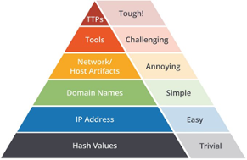
Pyramid of Pain
David J Bianco developed this idea in 2013
TTPs sit at the top of the IoCs and are thought to be the hardest thing to change because of the time, money and effort that goes into developing skills and infrastructure
Because of this they are thought to be a marker of a threat actor group

Slide 16
Attribution
Attribution to a particular threat actor group is supposed to help because:
It reveals motivations and objectives of the attackers and so can potentially help in stopping progression of an attack
Helps understand the impact of the attack e.g. crime vs espionage
MITRE ATT&CK framework is based entirely on this premise. Contains information about 110 different groups and hundreds of TTPs
Problems with this when you look at the actual distribution and uniqueness of the TTPs however
Attribution is a very difficult topic as it is so open to False Flags and geopolitical posturing

Slide 17
Incident Containment Eradication & Recovery
The first challenge is containment to stop further impact. This may involve:
Disabling accounts
Blocking network traffic
Isolating a computer or segment of the network
Balance the strategy against:
Potential damage to and theft of resources
Need for evidence preservation
Service availability
Time and resources needed
Effectiveness of the strategy
Duration
Alerting the attackers
Malware may detect attempts to disable and then take actions based on that

Slide 18
Incident Containment Eradication & Recovery
Eradication and recovery may involve rebuilding computers or recovering from backups
Must ensure that all malware is removed
Update accounts

Slide 19
Incident Post-Incident Activity
Lessons learned
Breach notification to appropriate authorities
Notification of affected users and follow-up
Reputation management
Insurance claims
Analysis of incident data

Slide 20
Digital Forensics
The discipline of collecting digital evidence that is related to an incident in such a way as to be able to be used in criminal and civil proceedings
Digital data may be present on a range of devices such as disks, computer memory, peripheral device (such as printers) memory, removable drives like USB drives, smartphones, IoT, cars (through navigation and entertainment systems.
Collecting this data involves doing so in a way that maintains the integrity of the data and its associated metadata (such as creation and modification times and dates)
Digital forensics specialists use specific devices that can image a disk or extract memory without the possibility of writing to the disk at the same time. This prevents any metadata from being changed.

Slide 21
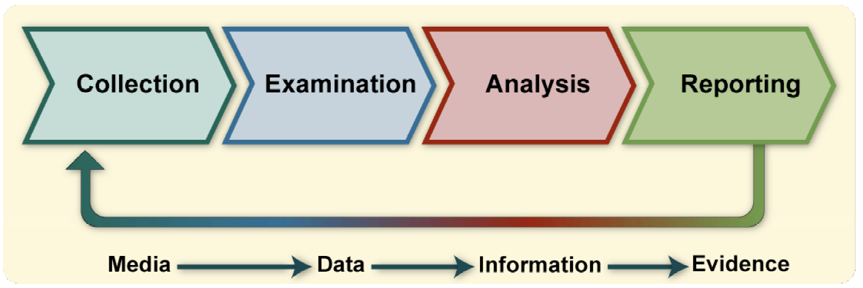
The Forensic Process
From NIST SP800-86 Guide to Integrating Forensic Techniques into Incident Response

Slide 22
Collection of Data
Identify possible sources of data
Other than devices, there may be 3rd Party records of activity such as ISP metadata retention, mobile phone company records, social media company information
Securing devices before someone is able to delete files or tamper with evidence is critical – although it is often possible to recover files that the user has thought they deleted (see next slide)
Data may be in encrypted forms which are potentially recoverable through access to memory where it is held in plaintext, decryption by knowing the keys or through some other technique

Slide 23
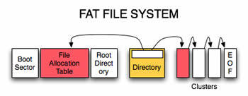
A note on file deletion
Most file systems use a table that holds information about where files are stored on the disk. They are stored in clusters and may not be contiguous
When a file is deleted, only the entry in the table is overwritten and so the data for the file remains on disk unless overwritten by subsequent file operations
A secure erase adds the steps of writing a sequence of 0s and 1s to the disk where the file is stored to completely obliterate the file – on a magnetic disk this may still be recoverable if not done comprehensively
The FAT file system was one of the first used for Windows computers and is still used for USB drives

Slide 24
Reverse Engineering
In some cases, malware collected may be unknown and working out how they work is called reverse engineering (the code is reverse engineered from the binary data in the program)
Malware employs evasion techniques to prevent reverse engineering and so it is challenging to do this
In 2017, Marcus Hutchins found a web domain in the ransomware WannaCry during the attack that when registered and set up caused WannaCry to stop attacking – it was a kill switch. After registering it however, it came under attack from a DDoS from the Mirai botnet
Incidentally, WannaCry exploited two vulnerabilities in Windows called DoublePulsar and EternalBlue that had been stolen from the NSA

Slide 25
Interesting Cases
Ross Ulbricht AKA Dread Pirate Roberts ran an illegal market place the Silk Road on the Dark Web
Ulbricht leaked information through his use of forums like BitcoinTalk, StackOverflow and accounts used on the Silk Road site. He talked obliquely about Silk Road on LinkedIn.
He used a VPN server with an IP address that was hard coded in the Silk Road source code
He used a real photo on fake IDs that were in a parcel intercepted by the FBI
The fake ID was used to rent servers that should have been invisible as they were on the Dark Web.
He used a CAPTCHA on the login page of Silk Road that leaked his real IP address

